Slide 1
HASS SA Conference 2018
HASS for a Fairer and Healthier Planet
Elspeth Grant
Golden Grove High School
elspeth.grant939@schools.sa.edu.au
elspethgrant@weebly.com (no www, check spelling, no .au)

Slide 2
First, about you!
Have you participated in the World’s Largest Lesson?
Existing knowledge about the Global Goals for Sustainable Development
Year levels
Teaching experience

Slide 3
A little about me
New teacher at Golden Grove High School this year
Was Coordinator, English, HASS & LOTE at Mark Oliphant College last year
Year 12 Society and Culture teacher at MOC from 2014
HTASA committee since 2012
Career change from museum curator
Exhibitions and public history, published academic research

Slide 4
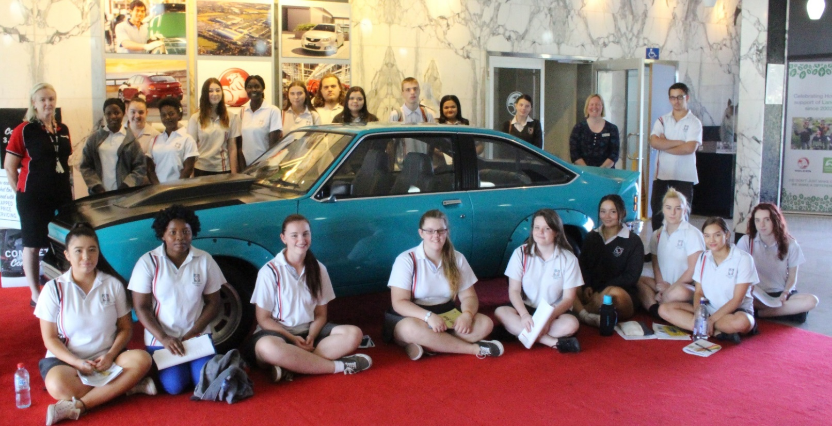
Context
Year 12 Society and Culture
One of four Folio tasks weighted 50% in total
Assessment criteria KU2, IA2, EC1, EC2
DECD Category 1 school
Differentiation
Students include dux aspirant, students aspiring to be first in family to finish high school and/or attend university, VET pathways, EALD, students from a refugee background, Indigenous students, students with intellectual disabilities, low literacy
Rich discussion with lots of perspectives to share
Notes:
KU2 Knowledge and understanding of the nature and causes of social change. IA2 Investigation and analysis of ways in which power structures operate in societies. EC1 Evaluation and use of evidence from a range of sources and perspectives, with appropriate acknowledgment of sources. EC2 Communication of informed ideas about societies and social and cultural issues.

Slide 5
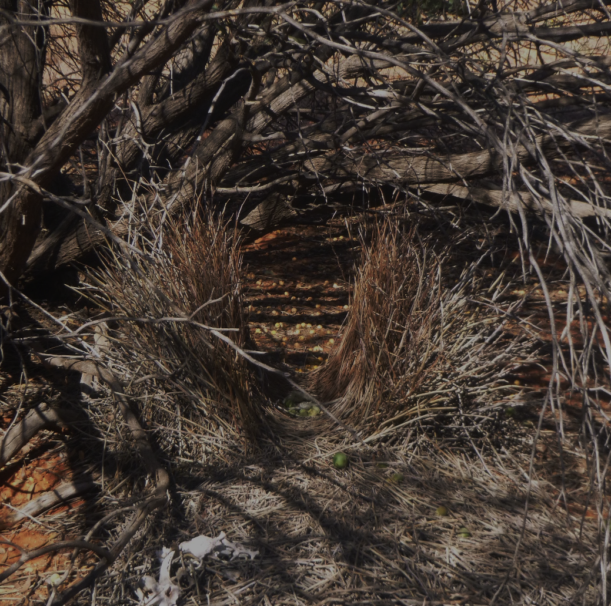
What will we get out of this?
Hopefully at least one of the ideas will be adaptable for your cohort, regardless of age!
Opportunity at end to share ideas on what you’ve already tried and/or how you might adapt
AC and SACE Cross-Curriculum Priority: Sustainability
AC and SACE Capabilities: Ethics, Intercultural Understanding, and more
Integration into HASS programs and beyond (e.g. “tagging” – more on this later)

Slide 6
Millennium
Development
Goals
2000-2015
Notes:
Global Education Centre poster

Slide 7
Ratified 25th September 2015
2015-2030

Slide 8
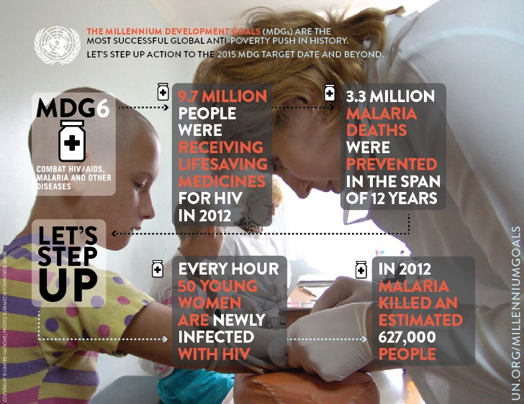
Good news but still work to do

Slide 9
Video
No Point Going Halfway
https://youtu.be/DdLqiTvFwJk

Slide 10
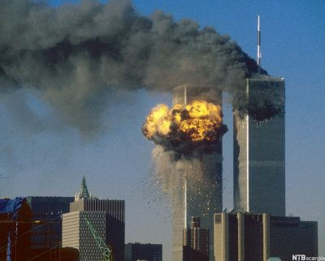
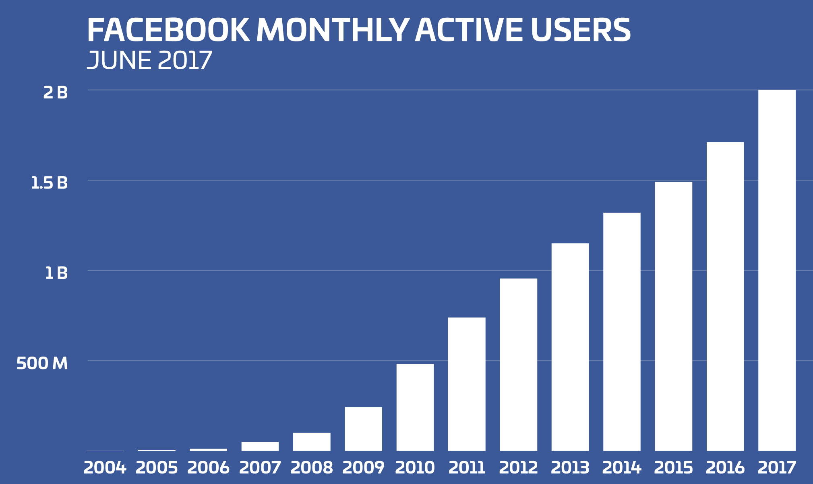
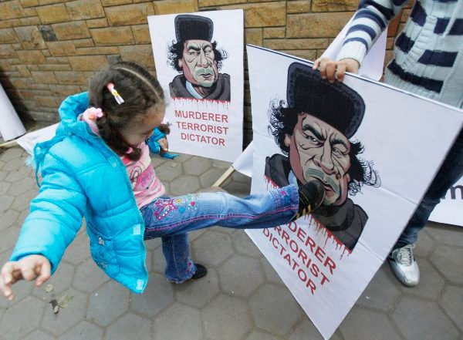
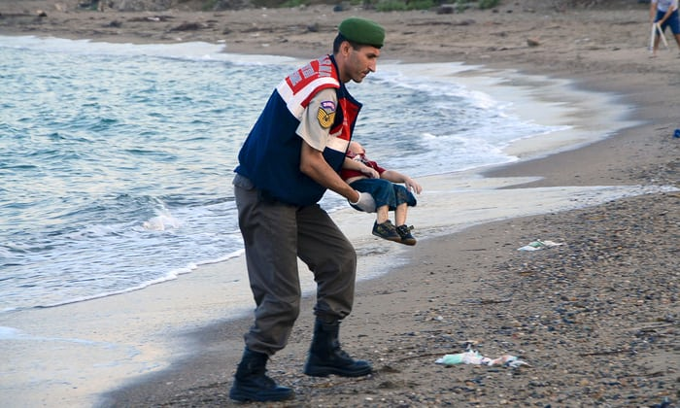
Looking forward, looking back
2000 compared with 2015 (KU2 Social Change)
8 MDGs, 17 GGs
Deeper consultation via social media (more on this later)
Shift from “developing nations”
What has changed?
Peace and justice absent
Conflicts since 2000
1 environmental MDG cf. 6 explicit environmental GGs
Science and technology
Awareness
What hasn’t changed?
Last goal
Note exact wording
e.g. “extreme”, “primary”

Slide 11
Ranking
Promoting familiarity and encouraging thinking from different perspectives
Most/Least Important
Whole world
Our community
Australia
Pick another country
Your grandparents
Your grandchildren

Slide 12
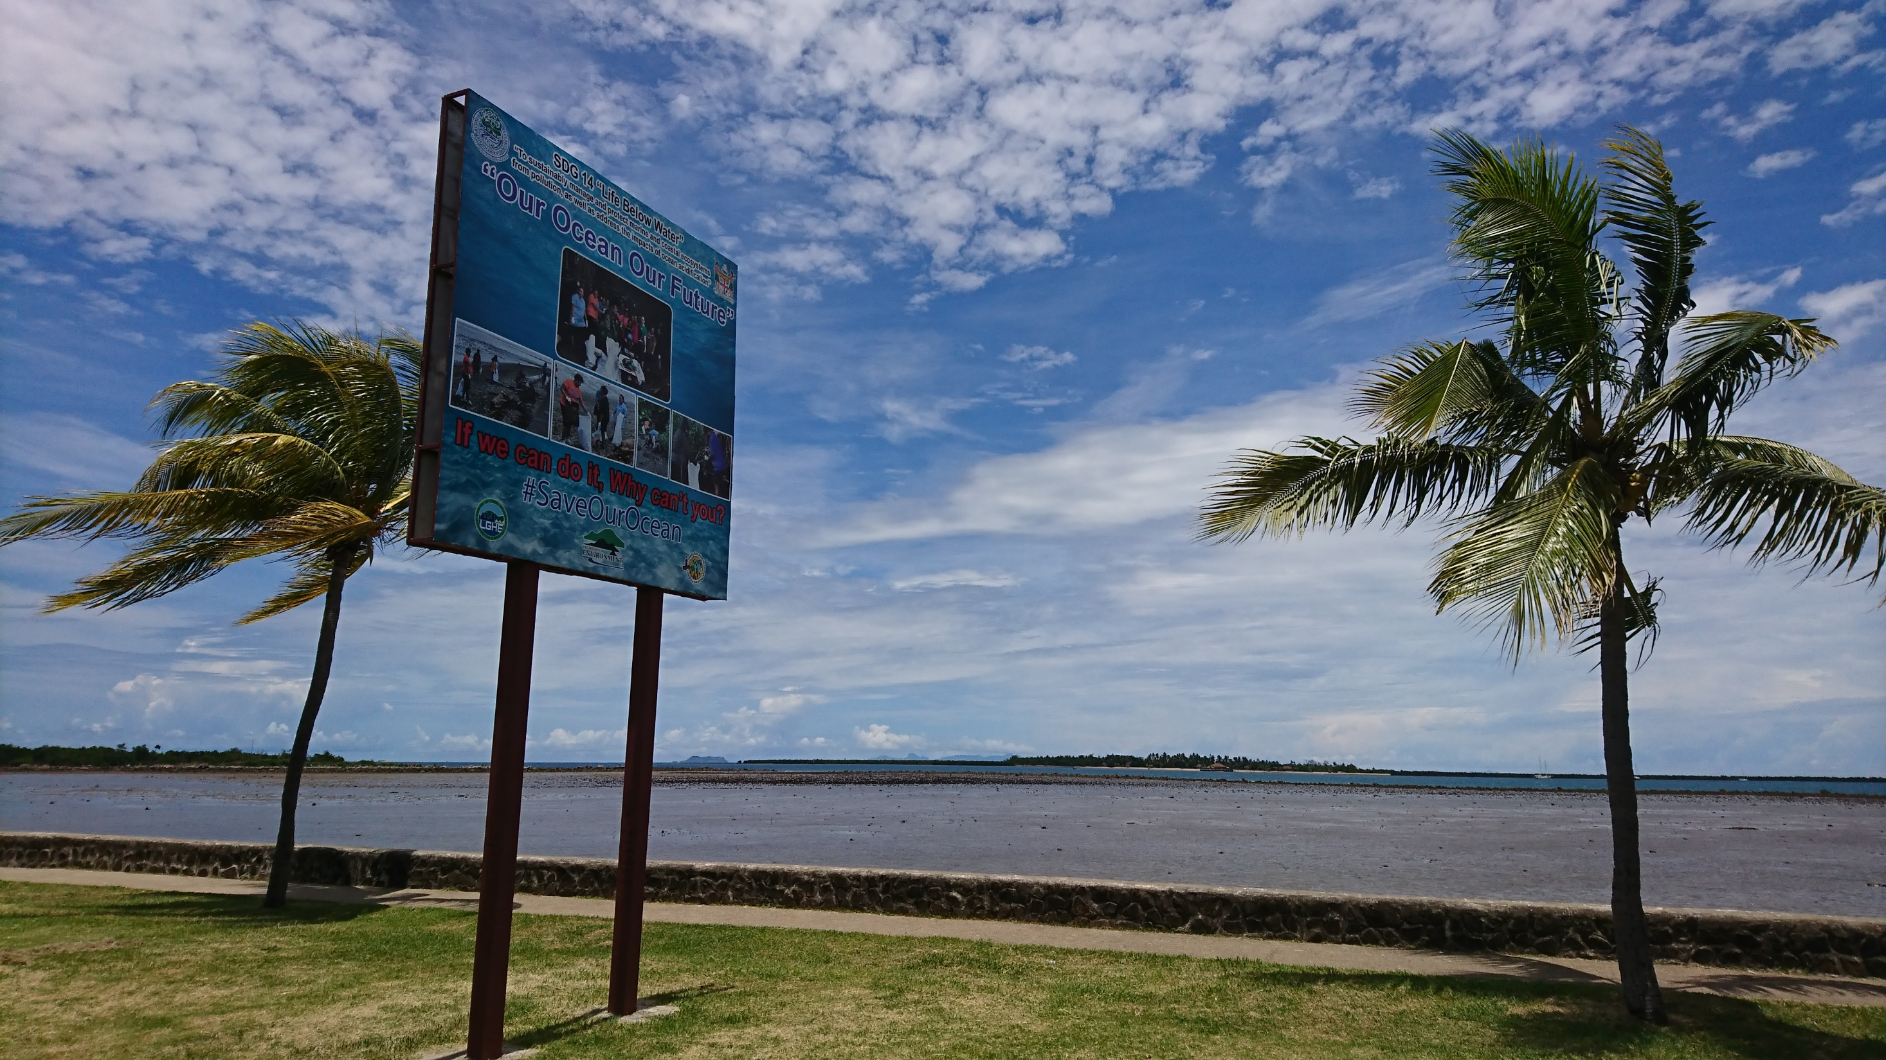

Slide 13
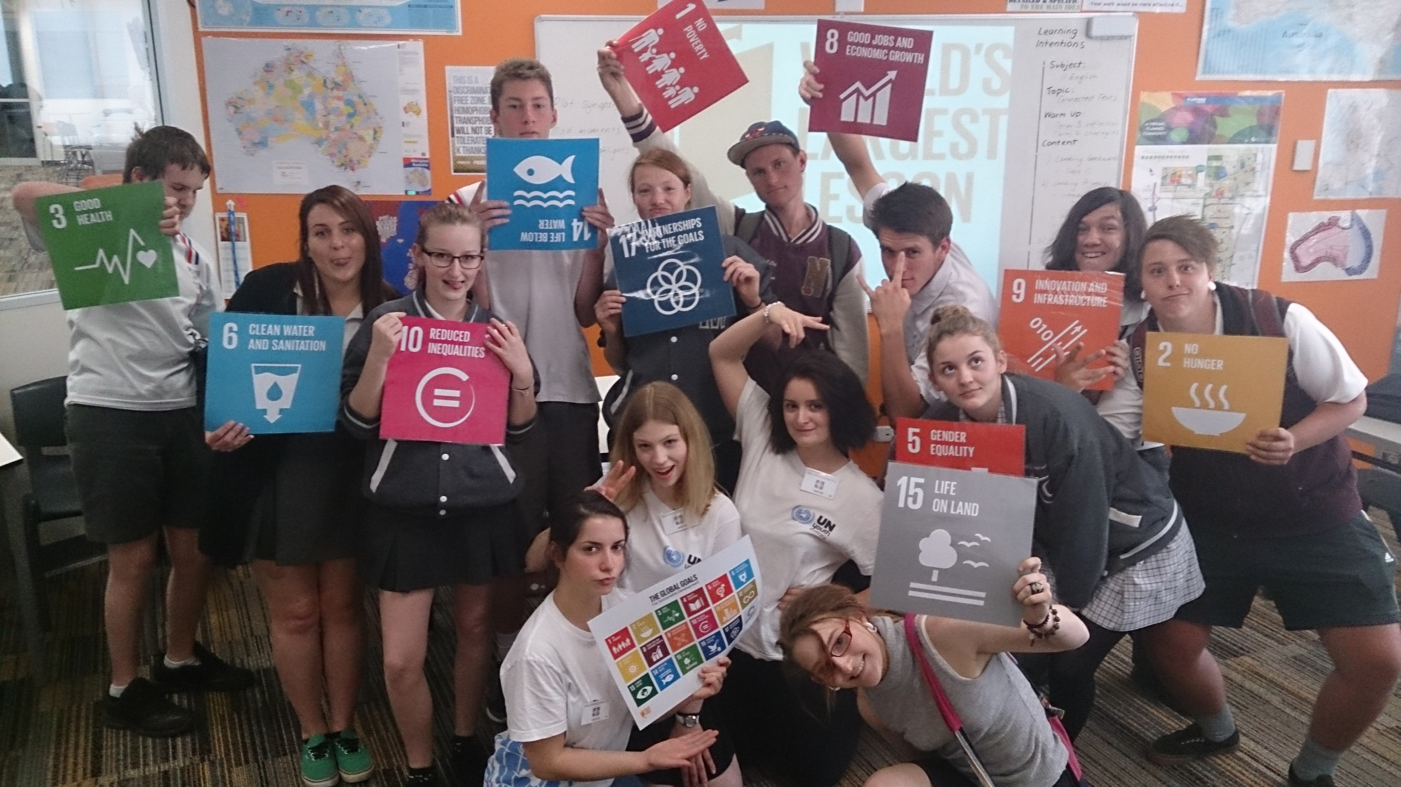
World’s Largest Lesson begins

Slide 14
Video
World’s Largest Lesson (2015)
https://youtu.be/cBxN9E5f7pc

Slide 15
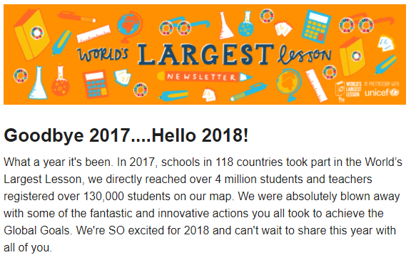

Slide 16
http://worldslargestlesson.globalgoals.org/languages/

Slide 17
Phase 1 – Raising Awareness
DECD Yr 10
Eden Prize
2018
IA2 Power Structures
#TellEveryone campaign
Empowerment through social media
Exploration of platforms
http://elspethgrant.weebly.com/folio-4-global-goals1.html
Greater reach (but to all?)
Target audience
How old will your students be in 2030?
Slactivism

Slide 18
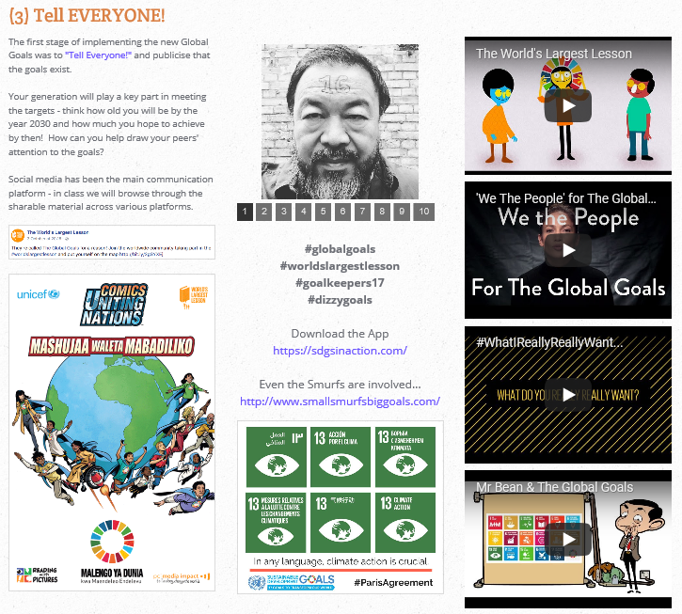

Slide 19
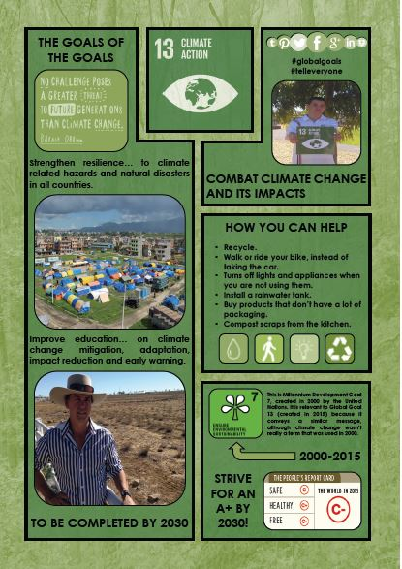
Phase 2 – Taking Action
EC2 Communication of informed ideas
IA2 Investigation and analysis of ways in which power structures operate in societies
2016 – Infographic
2017 – New targets for each of the GGs (169!)
Combined with students’ knowledge of social media (or maybe not)
Getting peers to take action
Justify approach
Encourages analysis of own work
Examples

Slide 20
Video
Numbers in Action
https://youtu.be/Mdm49_rUMgo

Slide 22
Embedding through “Tagging”
Universal Declaration of Human Rights (1948)
Year 10 History – Rights and Freedoms
Youth for Human Rights posters (order a free kit!)
For any contemporary issue you are discussing, identify relevant UDHR Article/s or Global Goal.
[Global perspective for local issues in Investigations.]
Idea for a further activity from Fiji Museum…

Slide 23
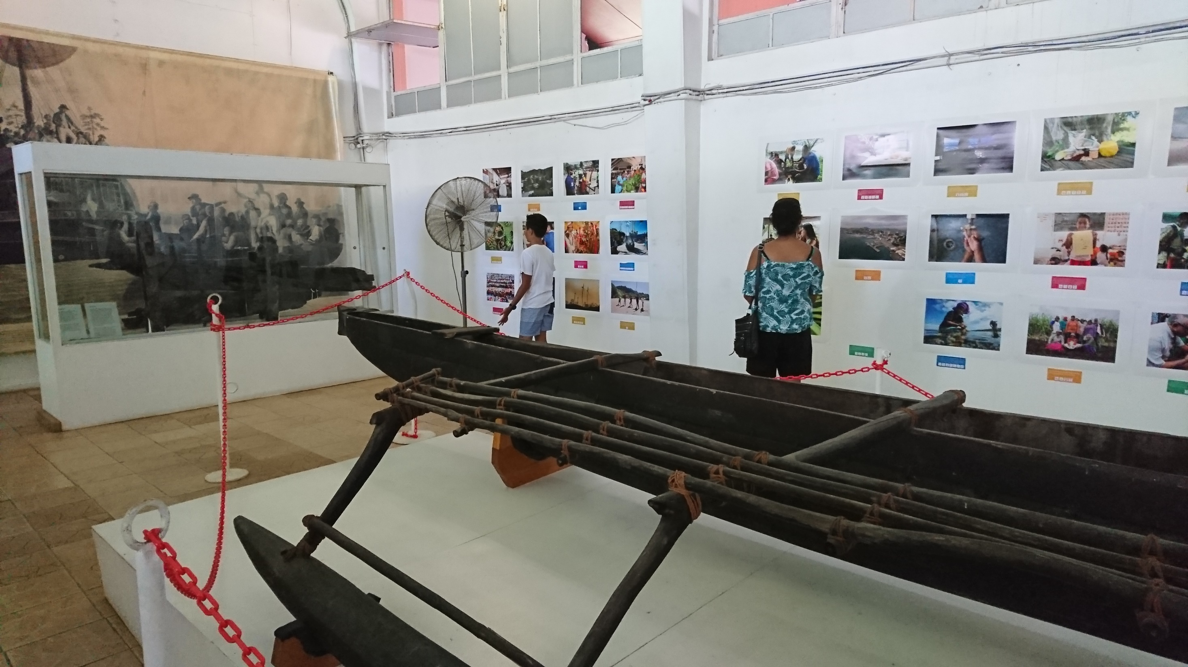

Slide 25
Global Networking
With other students and educators across the world
http://worldslargestlesson.globalgoals.org/ Online course to share with colleagues + many other resources
Facebook pages to follow, groups to join:
World’s Largest Lesson
Global Goals for Sustainable Development
Video
World’s Largest Lesson
Global Slideshow
https://vimeo.com/176329576

Slide 26
Where to next?

